Slide 1
3

Slide 2
2

Slide 3
1

Slide 4
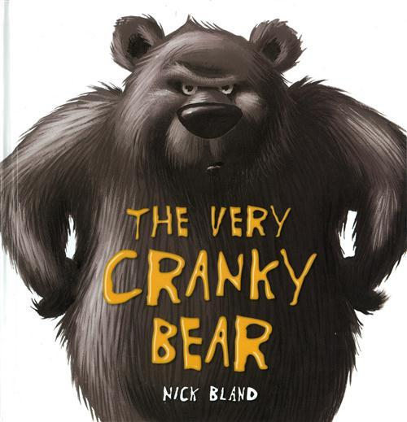

Slide 5
The Very Cranky Bear

Slide 6
There were 4 animals in the jingle jangle jungle and it was raining.

Slide 7
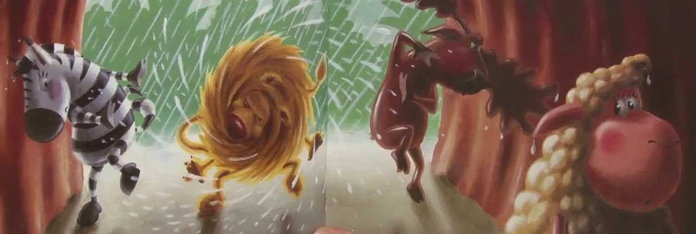

Slide 8
The 4 Animals were in a bear’s cave and the bear was sleeping in the cave.

Slide 9
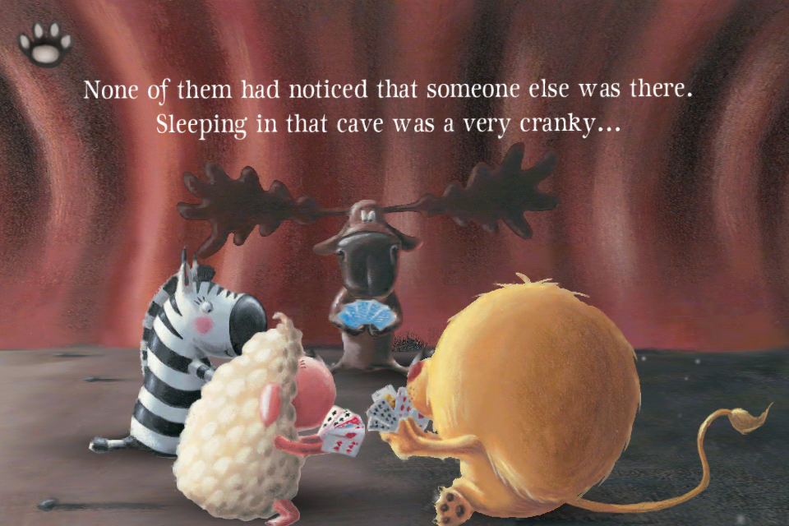

Slide 10
What will happen to the animals?

Slide 11
Will the bear eat the 4 animals?

Slide 12
Or will they escape?

Slide 13
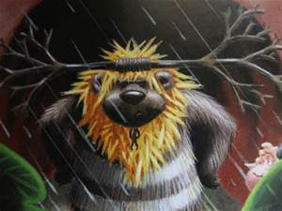

Slide 14
Find out by reading the book.

Slide 15
Created by Dural and Justin
Music
www.purpleplanet.com

