Slide 1
3

Slide 2
2

Slide 3
1

Slide 5
One day Colin Jenkins was
sleeping under a tree. He
slept for a long time.

Slide 6
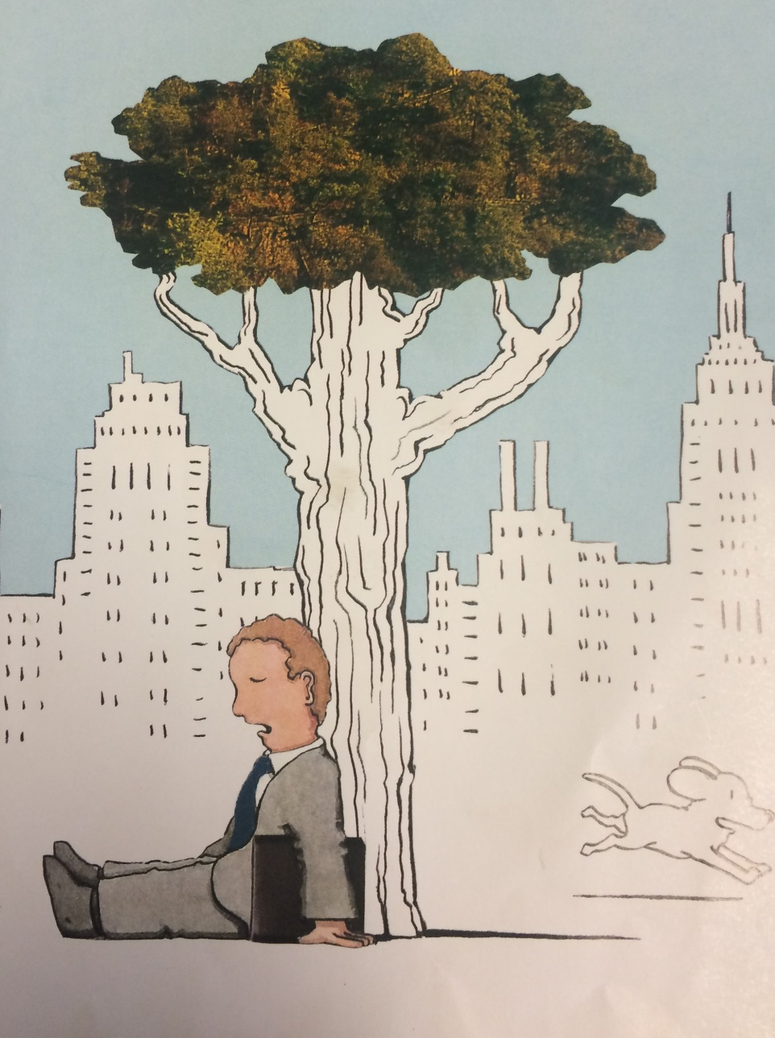

Slide 7
When he woke up he went on a
train back home.

Slide 8
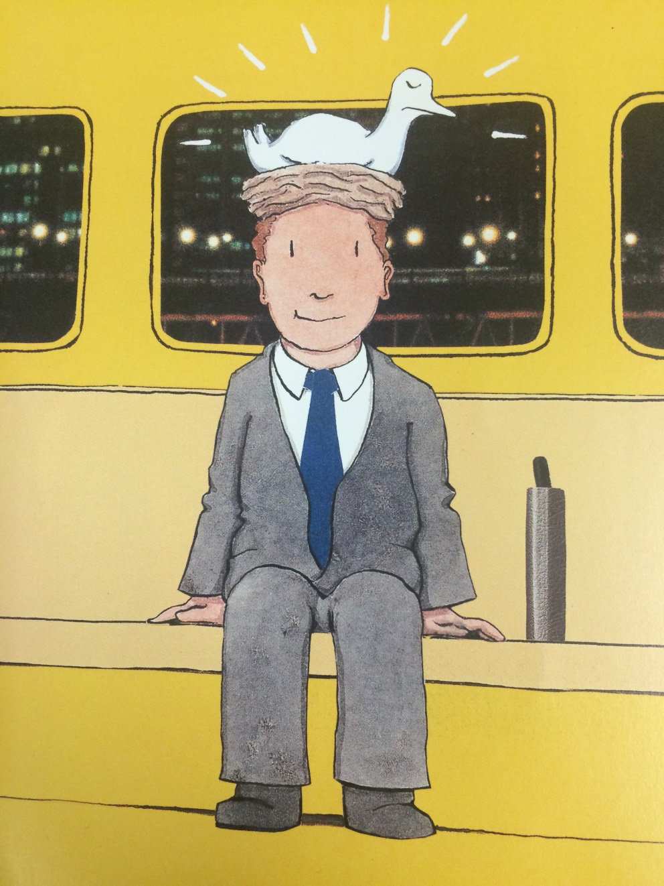

Slide 9
He does not realise there is a bird’s nest on his
head.

Slide 10
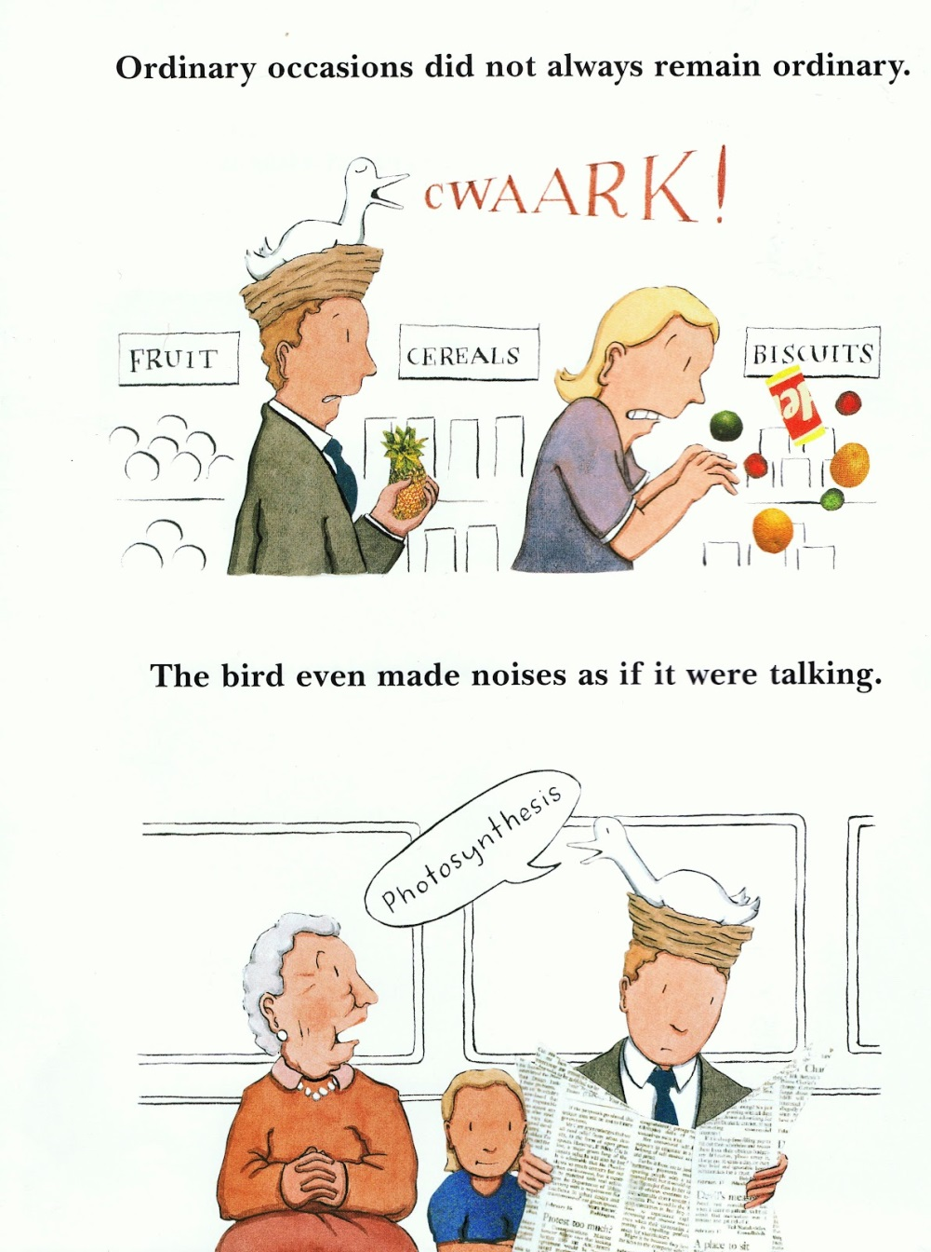

Slide 11
Does his family notice?

Slide 12
Will he find out there is a bird on his head?

Slide 13
Read this book to find out.

Slide 14
Makayla and Patrick
Music from www. Purple planet.com
Images from google

